Slide 1

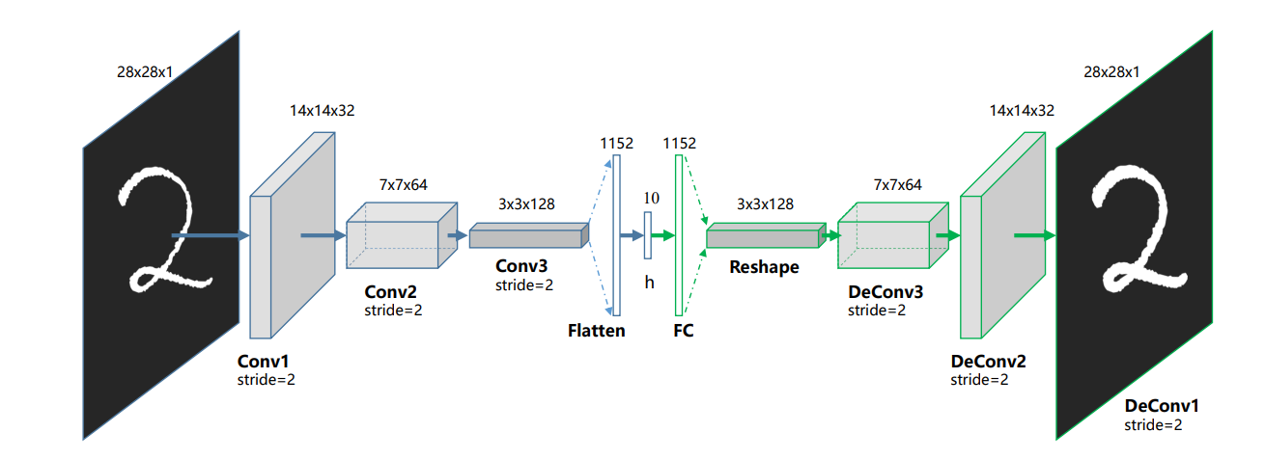
Deep Clustering with Autoencoders
Elad Sofer and Yehonatan Dahan
Guo, Xifeng & Liu, Xinwang & Zhu, En & Yin, Jianping. (2017). Deep Clustering with Convolutional Autoencoders. 373-382. 10.1007/978-3-319-70096-0_39.

Slide 2
Introduction
Motivation
Reducing the dimension and why we need it for clustering?
Feature Selection: Dimensionality reduction helps in selecting the most relevant features for clustering while discarding redundant or noisy ones.
Curse of Dimensionality: In high-dimensional spaces, the density of data points tends to become sparse, making it challenging to distinguish meaningful patterns or clusters.
Noise Reduction: In high-dimensional spaces, noise or irrelevant variations in the data can hinder the clustering process.
Visualization/Evaluation: Dimensionality reduction techniques can map high-dimensional data to two or three dimensions, enabling visual inspection of the data and clusters.

Slide 3
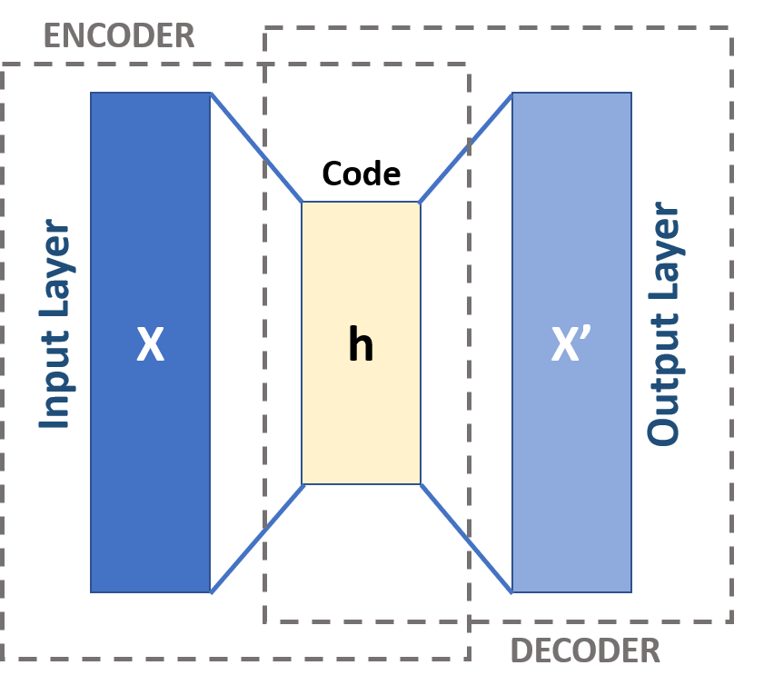
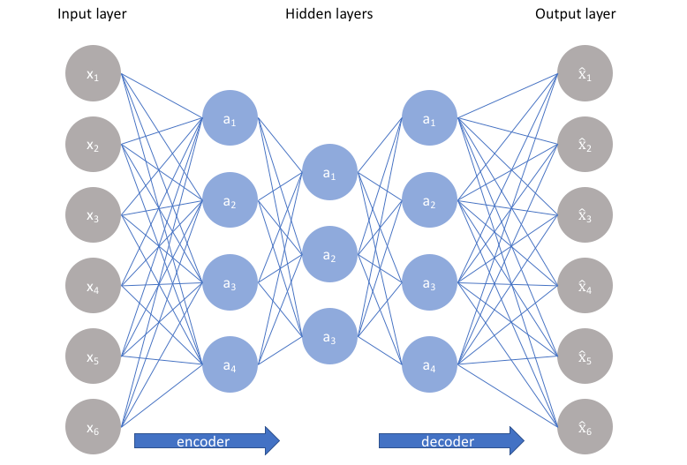


Autoencoders
General
Unsupervised neural network for data compression and feature learning
Encoder compresses data into a lower-dimensional representation (latent space)
The Decoder reconstructs the original input from the latent space
Trained to minimize the difference between input and output
The AE could be implemented with different architectures (Fully connected, Convolution layers, etc.)

Slide 4
AUTOENCODER CLUSTERING Algorithm Evolution
Simple DEC - Autoencoder
IDEC – Improved Deep Embedded Clustering with Local Structure Preservation
DCEC – Deep Convolutional Embedded Clustering
DEC-DA - Deep Embedded Clustering with Data Augmentation

Slide 5
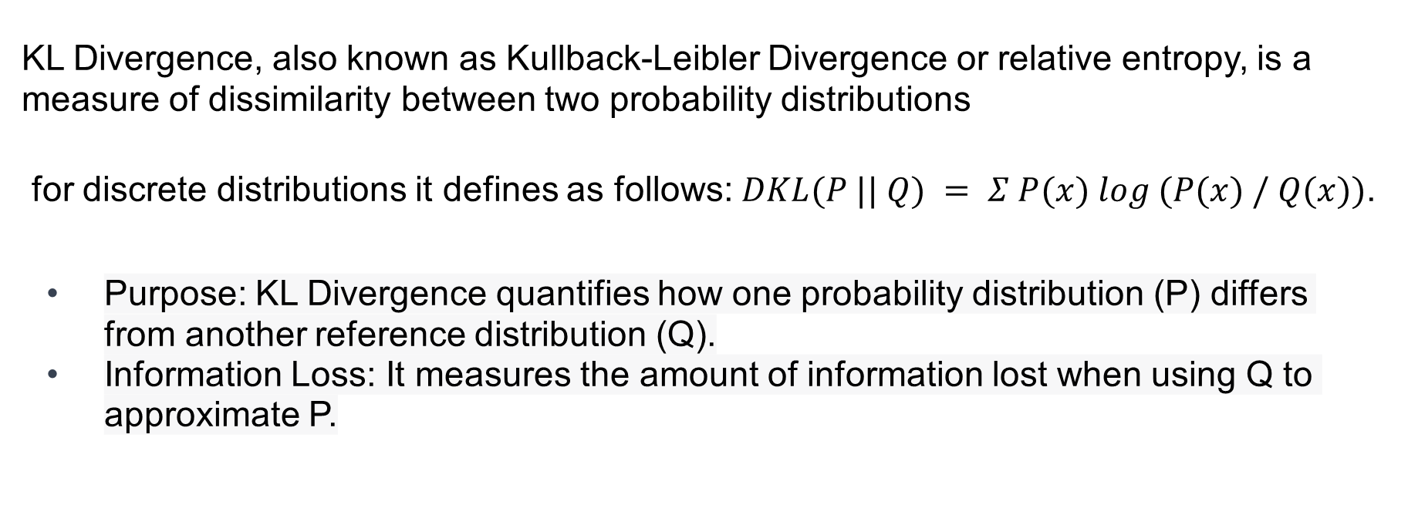
KL divergence
KL Divergence, also known as Kullback-Leibler Divergence or relative entropy, is a measure of dissimilarity between two probability distributions
for discrete distributions it defines as follows: $DKL(P || Q) = Σ P(x) log (P(x) / Q(x))$.
Purpose: KL Divergence quantifies how one probability distribution (P) differs from another reference distribution (Q).
Information Loss: It measures the amount of information lost when using Q to approximate P.

Slide 6
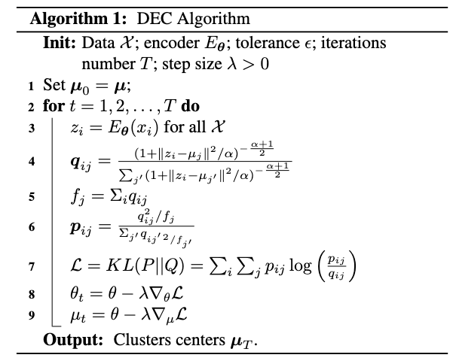
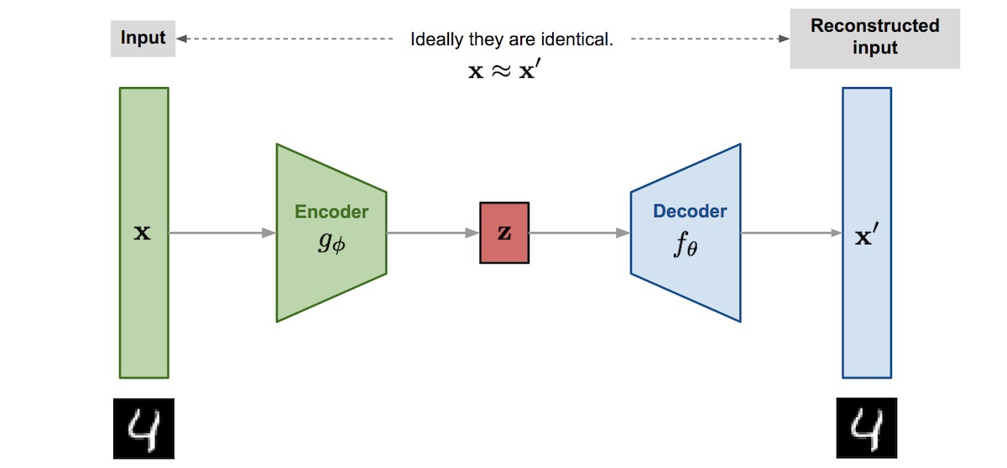
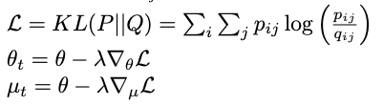
Deep Embedded Clustering Analysis (DEC)
Pretraining
Use a deep autoencoder to learn a lower dimension feature representation of the input data, as well as eliminating noise variations.
Objective
Simultaneously learn feature representations and cluster assignments in an end-to-end manner.
Discover underlying cluster structure in unlabeled data.
Junyuan Xie, Ross Girshick, Ali Farhadi,
“Unsupervised Deep Embedding for Clustering Analysis”. https://doi.org/10.48550/arXiv.1511.06335
Notes:
Fully Connected

Slide 7
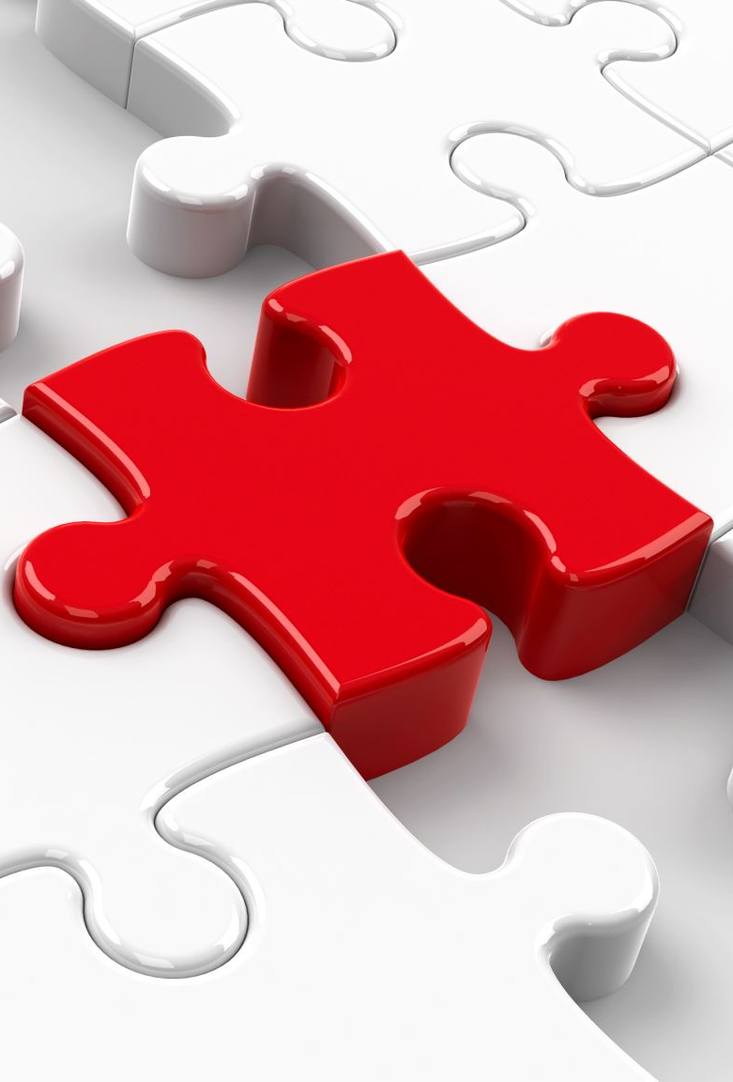
Does the structure oF X preserve?
In summary, Deep Embedded Clustering (DEC) is an unsupervised learning method that combines deep autoencoders with clustering.
By jointly learning feature representations and cluster assignments, DEC aims to discover underlying cluster structures in unlabeled data.

Slide 8
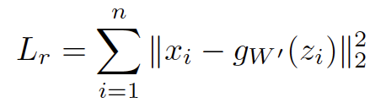
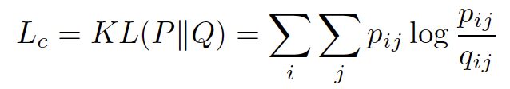
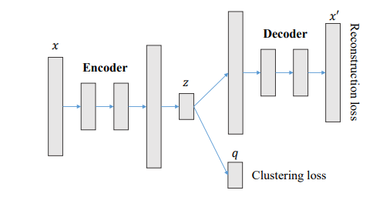
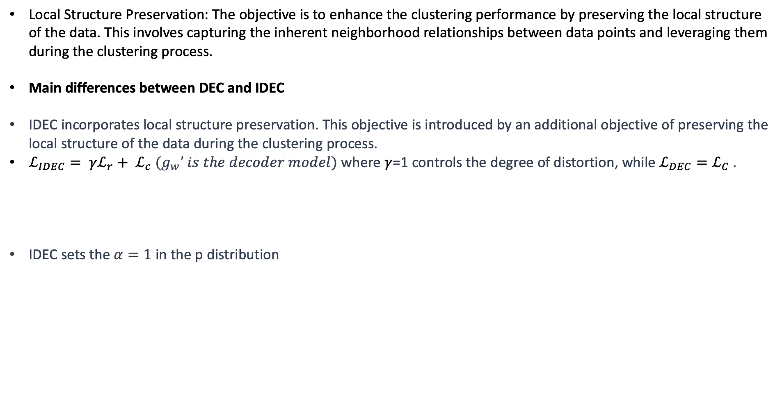
Improved Deep Embedded Clustering
(IDEC)
Local Structure Preservation: The objective is to enhance the clustering performance by preserving the local structure of the data. This involves capturing the inherent neighborhood relationships between data points and leveraging them during the clustering process.
Main differences between DEC and IDEC
IDEC incorporates local structure preservation. This objective is introduced by an additional objective of preserving the local structure of the data during the clustering process.
$ℒ_{IDEC}= {{γℒ}_{r}+ ℒ}_{c}$ $(g_{w}’ is the decoder model)$ where $γ$=1 controls the degree of distortion, while $ℒ_{DEC}=$ $ℒ_{C}$ .
IDEC sets the $α=1$ in the p distribution
Guo, Xifeng & Gao, Long & Liu, Xinwang & Yin, Jianping. (2017). Improved Deep Embedded Clustering with Local Structure Preservation. 10.24963/ijcai.2017/243.

Slide 9
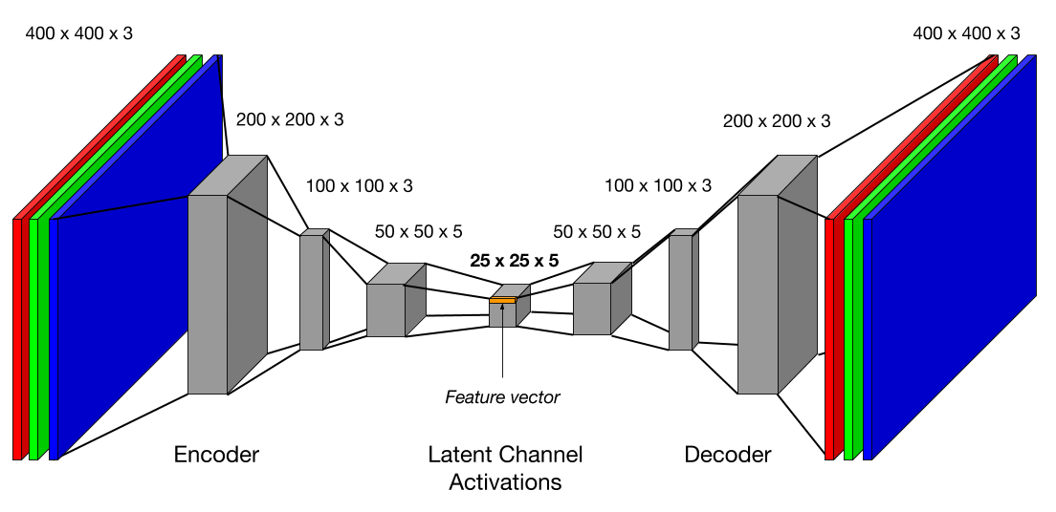
Autoencoders
Convolutional Autoencoders
CAE structure for learning features from images
Superior to other autoencoders in handling images
Convolutional layers capture spatial relationships in images

Slide 10
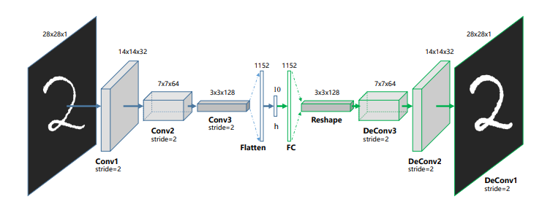
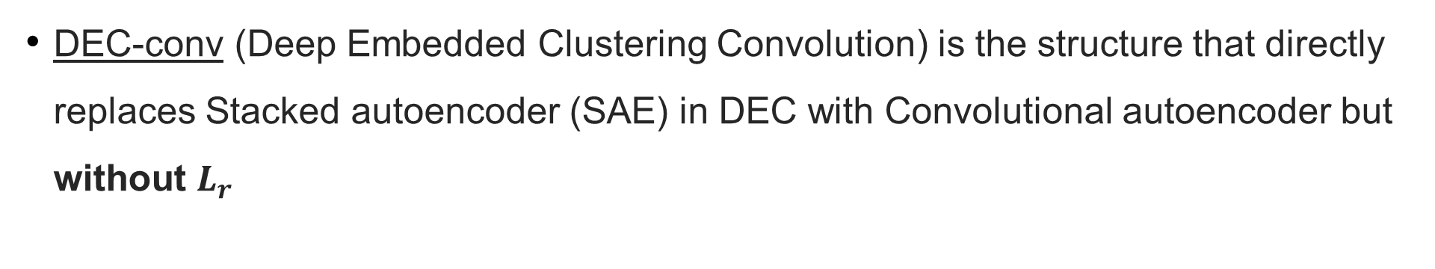
Adding a Convolution Layer
DEC-conv (Deep Embedded Clustering Convolution) is the structure that directly replaces Stacked autoencoder (SAE) in DEC with Convolutional autoencoder but without $L_{r}$
Guo, Xifeng & Liu, Xinwang & Zhu, En & Yin, Jianping. (2017). Deep Clustering with Convolutional Autoencoders. 373-382. 10.1007/978-3-319-70096-0_39.

Slide 11
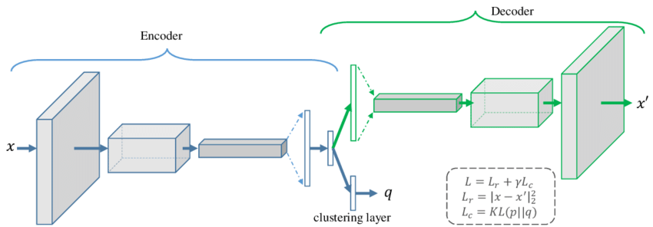
Deep Convolutional Embedded Clustering
(DCEC)
Extension of Deep Embedded Clustering (DEC) with CAE
Combination of CAE and clustering loss in DCEC
Clustering layer guides feature space for cluster formation
Guo, Xifeng & Liu, Xinwang & Zhu, En & Yin, Jianping. (2017). Deep Clustering with Convolutional Autoencoders. 373-382. 10.1007/978-3-319-70096-0_39.

Slide 12
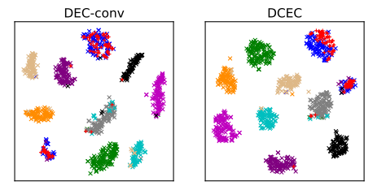
DEC-conv Vs. DCEC
T-SNE Visualization
Guo, Xifeng & Liu, Xinwang & Zhu, En & Yin, Jianping. (2017). Deep Clustering with Convolutional Autoencoders. 373-382. 10.1007/978-3-319-70096-0_39.

Slide 13
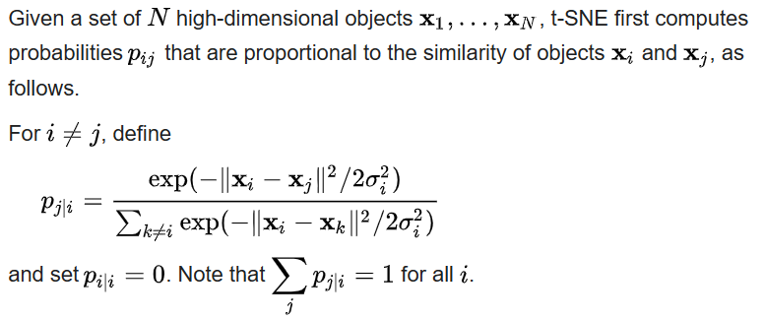
t-distributed stochastic neighbor embedding (t-SNE)

Slide 14
Deep Embedded Clustering with Data Augmentation
(DEC-DA)
Introduced data augmentation to unsupervised deep embedded clustering (DEC) for the first time
Augmentation was done by random rotation, shifting, and cropping of the images
Conducted extensive experiments to validate the effectiveness of data augmentation for finetuning
Achieved state-of-the-art clustering performance on image datasets
Guo, Xifeng & Zhu, En & Liu, Xinwang & Yin, Jianping. (2018). Deep Embedded Clustering with Data Augmentation.

Slide 15
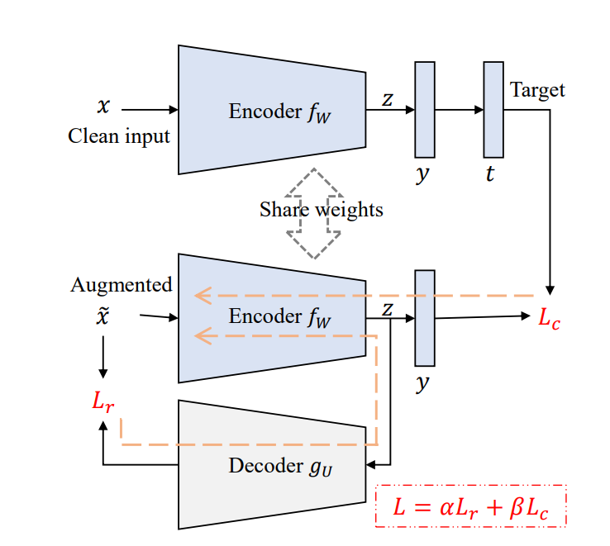
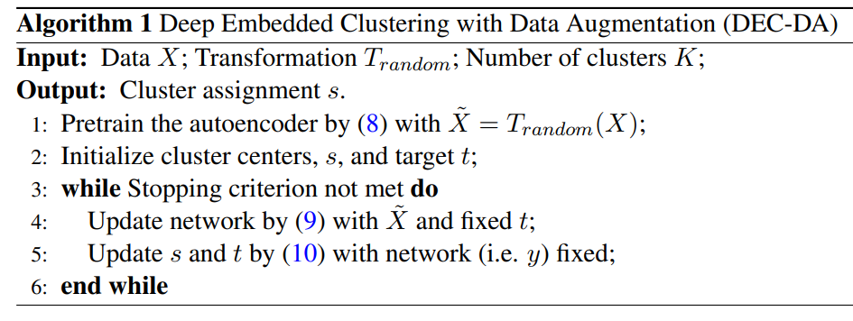
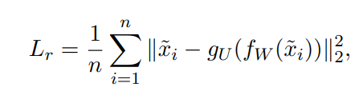



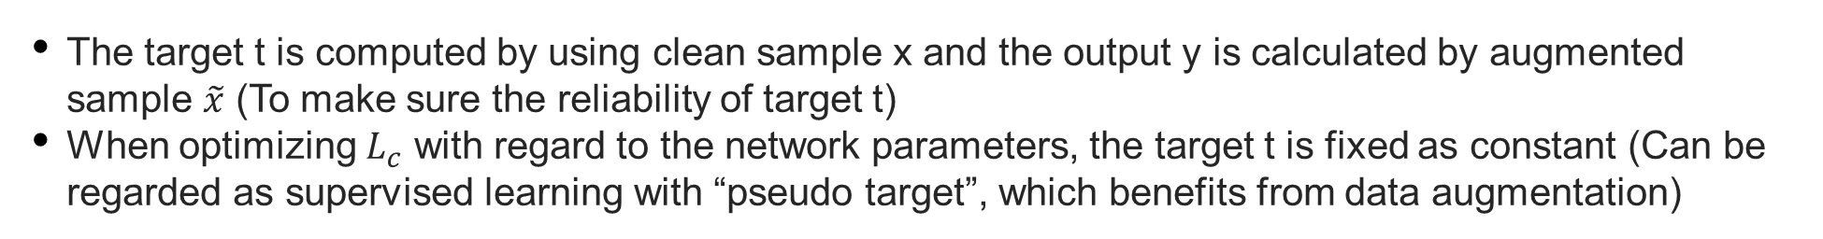
Deep Embedded Clustering with Data Augmentation
(DEC-DA)
The target t is computed by using clean sample x and the output y is calculated by augmented sample $\tilde{x}$ (To make sure the reliability of target t)
When optimizing $L_{c}$ with regard to the network parameters, the target t is fixed as constant (Can be regarded as supervised learning with “pseudo target”, which benefits from data augmentation)
Guo, Xifeng & Zhu, En & Liu, Xinwang & Yin, Jianping. (2018). Deep Embedded Clustering with Data Augmentation.

Slide 16
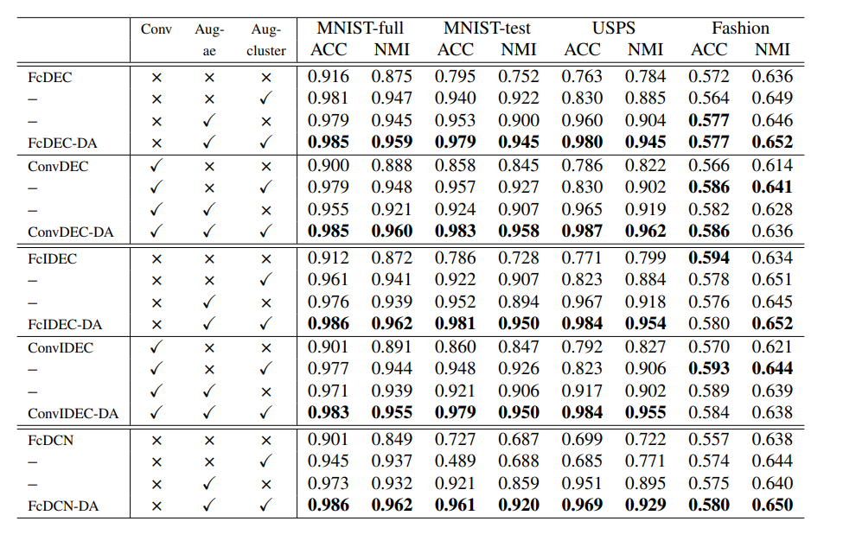
Results
“Conv” - convolutional networks
“Aug-ae” - data augmentation during pretraining
“Aug-cluster” - data augmentation during finetuning
MNIST-full: A dataset consisting of 10 handwritten digits (LeCun et al., 1998), total 70,000 samples. Each sample is a 28x28 gray image.
MNIST-test: A dataset that only contains the test set of MNIST-full, with 10,000 samples.
USPS1: A dataset contains 9298 gray digit images with size of 16x16.
Fashion: A dataset of Zalando’s article images, consisting of 70,000 examples each of which is a 28x28 gray image, divided into 10 classes (Xiao et al., 2017).
Notes:
*Normalized Mutual Information (NMI) is a normalization of the Mutual Information (MI) score to scale the results between 0 (no mutual information) and 1 (perfect correlation)

Slide 17
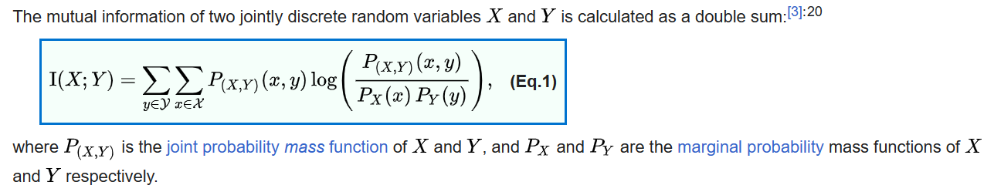
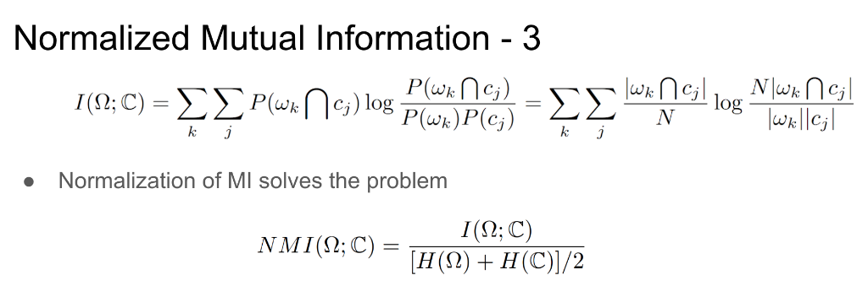
Mutual information

Slide 18
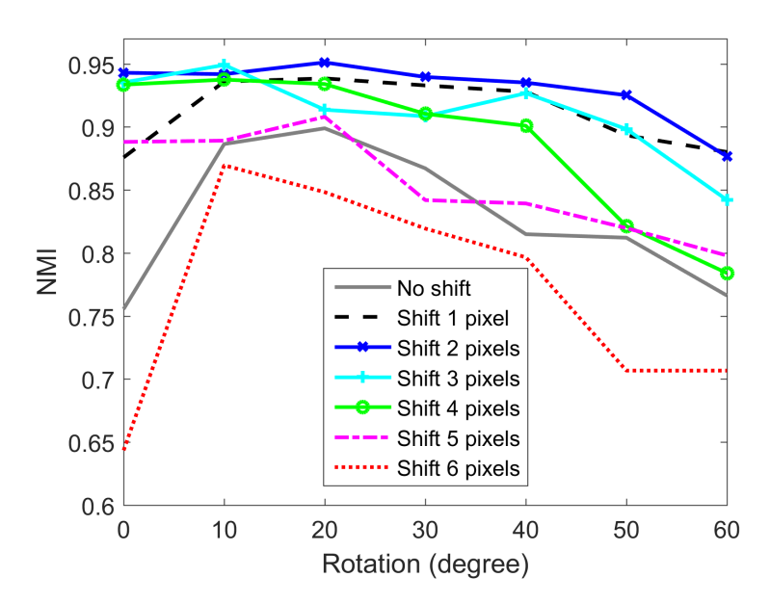
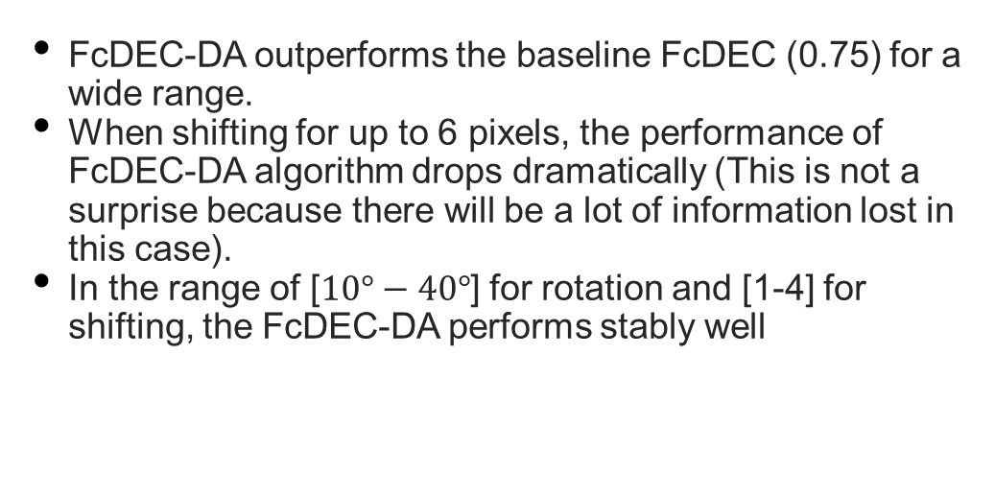
Results
Sensitivity analysis for the transformations (rotation and shifting) used in data augmentation on MNIST-test:
FcDEC-DA outperforms the baseline FcDEC (0.75) for a wide range.
When shifting for up to 6 pixels, the performance of FcDEC-DA algorithm drops dramatically (This is not a surprise because there will be a lot of information lost in this case).
In the range of [$10°−40°$] for rotation and [1-4] for shifting, the FcDEC-DA performs stably well
*Normalized Mutual Information (NMI) is a normalization of the Mutual Information (MI) score to scale the results between 0 (no mutual information) and 1 (perfect correlation)

Slide 19
Conclusion and future work
During this studies we have learned about different variation of Deep Clustering with Autoencoders
By using Improved Deep Embedded Clustering (IDEC) for Local Structure Preservation, the results improved.
Implementation of Convolution layer for the images clustering was found to be effective.
The approach of Deep Embedded Clustering with Data Augmentation (DEC-DA) has been proved to improve the results of the different algorithms
In our future work, we will implement the different algorithms and make a comparison

Slide 20
Do you have any questions?
Thank you

